Slide 1

Analysis of Universities' Financials Insights from Form 990 Data
Alexander Assab, Carly-Anna Barba, Tyler Cody, Keara Conroy, Dimitri Dabydeen, Ryan Darling, Kali Grimes, Aliyah Jackson, Knut Lundstrom-Svahnqvist, Gregory Perry, Braeden Tudryn, & Stephen Ventura

Slide 2
Introduction
Problem Statement:
Universities must balance financial health with their mission, using IRS Form 990 to analyze metrics like revenue, expenses, and compensation for better efficiency in a competitive academic landscape.
Research Objective:
Analyze Western New England University's financial health
Analyze operational performance through audited financial statements to assess stability and management
Scope of Analysis:
Focuses on 22 private universities in southern New England (2004-2023)
Covering metrics such as revenues, expenses, net income, assets, liabilities, contributions, program services, and compensation expenses.

Slide 3
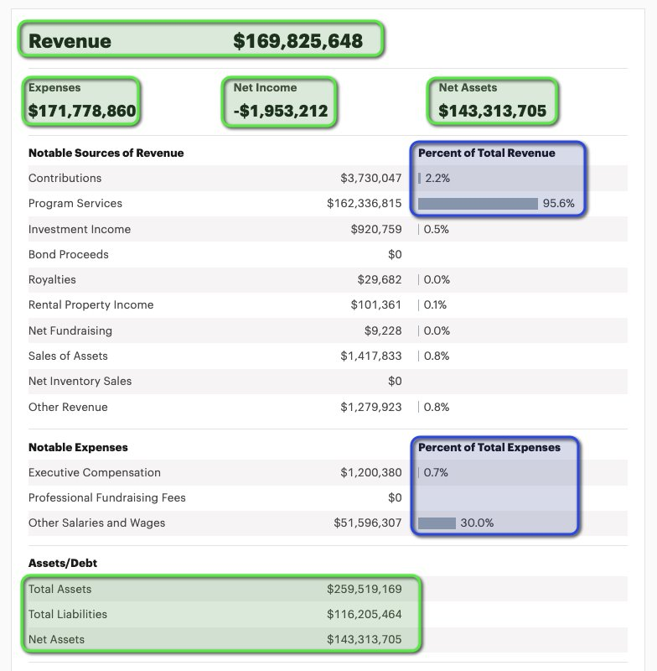
Methodology
Data Collection Method: Each student manually collected 20 years of IRS Form 990 data for assigned universities by downloading and reviewing each tax document.
Review Process: Team members reviewed the manually gathered data throughout the analysis process to ensure accuracy.
Metrics Developed: Five core metrics were created to analyze the data:
Time series data for all universities.
Time series data for similar universities.
Compound Annual Growth Rate (CAGR) for all universities.
CAGR for similar universities.
Year-over-year changes.
Outcome: Manual data collection provided more reliable and comprehensive than initial AI-based attempts.

Slide 4
Data Analysis & Findings
10 Variables for Analysis
22 Universities for Analysis​
Net Income
Total Revenue
Total Expenses
Net Assets
Total Assets
Total Liabilities
Contributions
Program Services Revenue
Executive Compensation
Other Salaries and Wages
Nichols College
Northeastern University
Quinnipiac University
Roger Williams University
Sacred Heart University
Springfield College
Suffolk University
University of Hartford
Wesleyan University
Western New England University
Worcester Polytechnic Institute
American International College
Boston College
Boston University
Brandeis University
Bryant University
Clark University
Endicott College
Fairfield University
Lesley University
Massachusetts Institute of Technology
Merrimack College

Slide 5
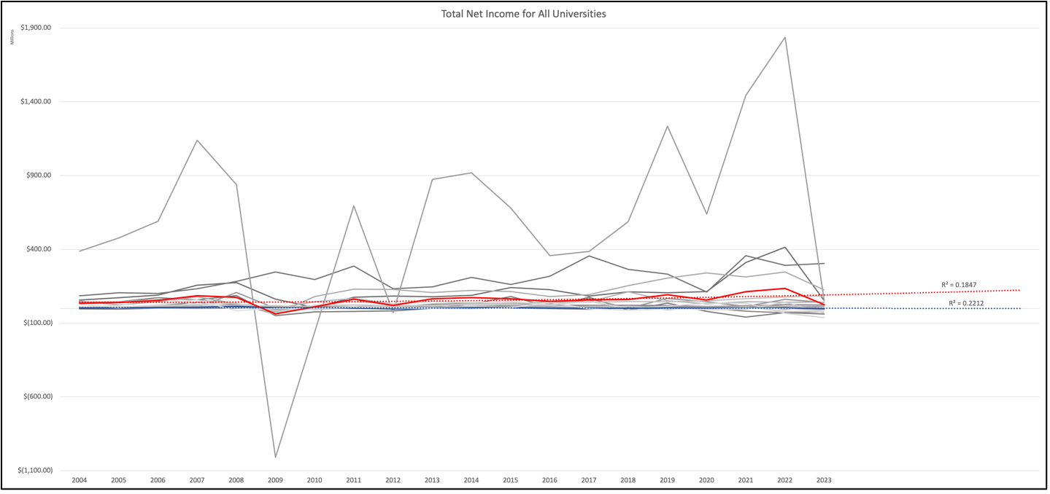
Net Income
Average
WNEU

Slide 6
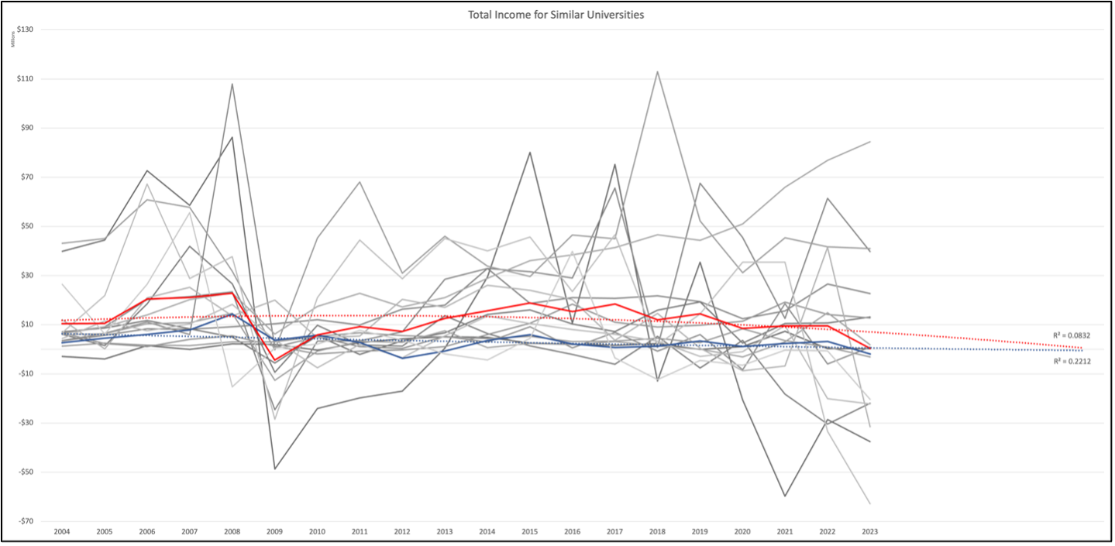
Net Income - don’t forget to change title on chart

Slide 7
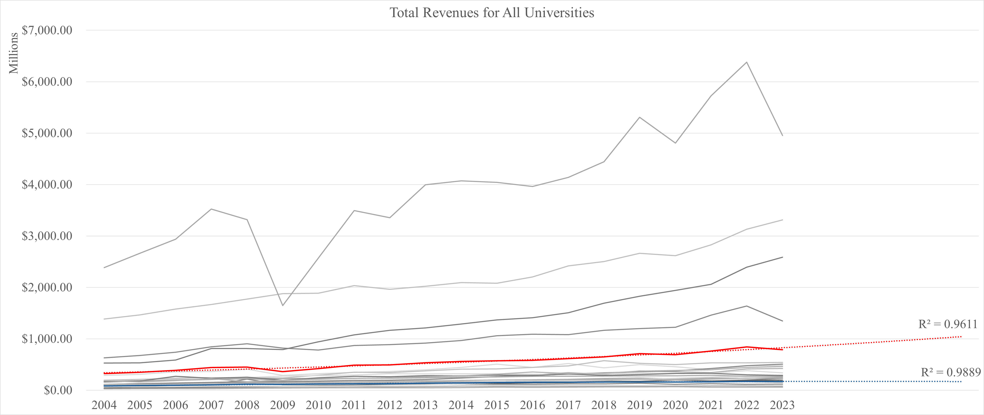
Total Revenue

Slide 8
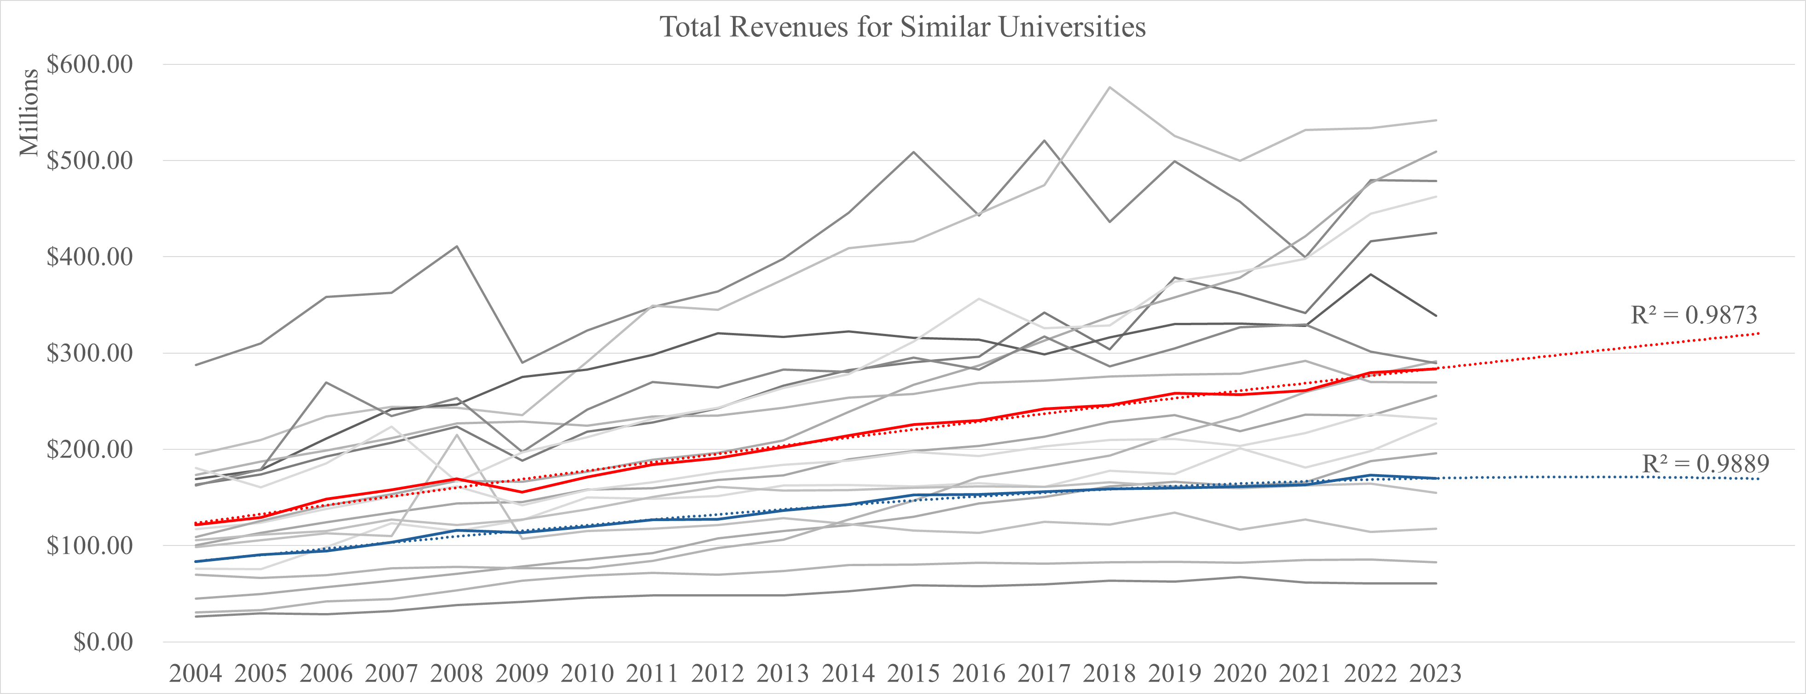
Total Revenue

Slide 9
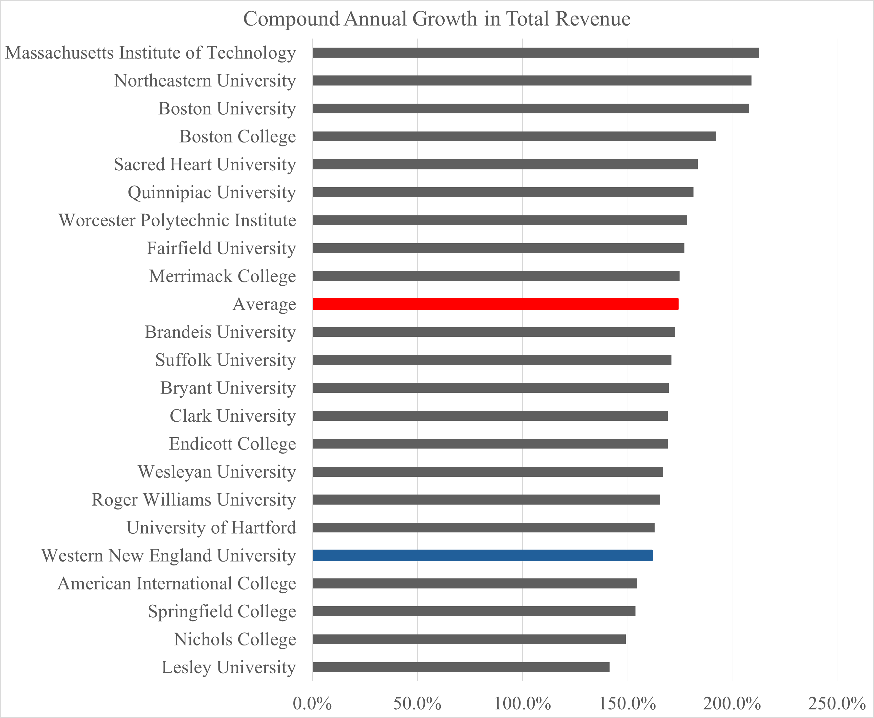
Total Revenue (CAGR)

Slide 10
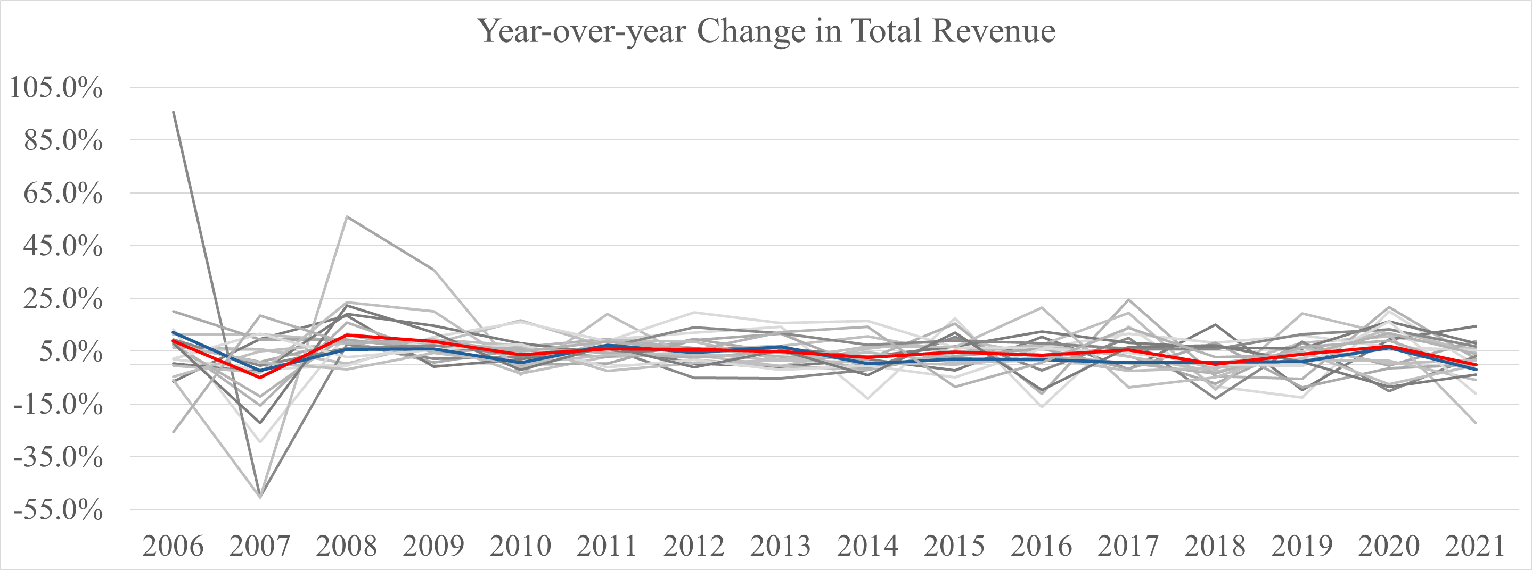
Total Revenue (YoY Change)

Slide 11
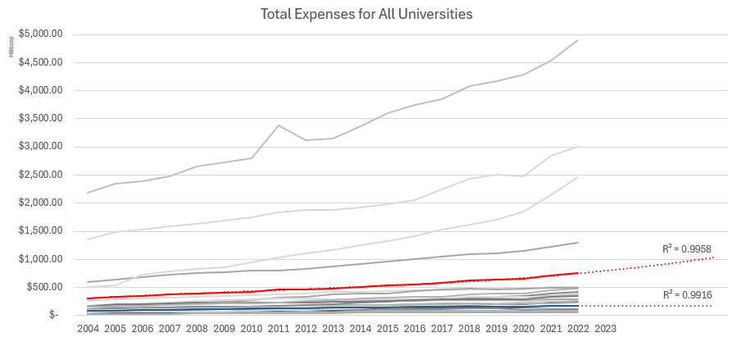
Total Expenses

Slide 12
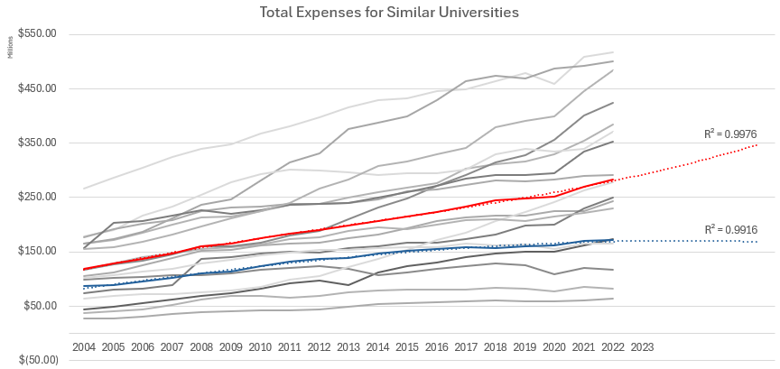
Total Expenses

Slide 13
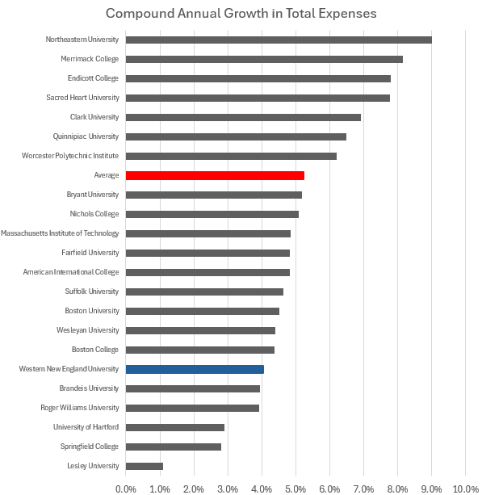
Total Expenses (CAGR)

Slide 14
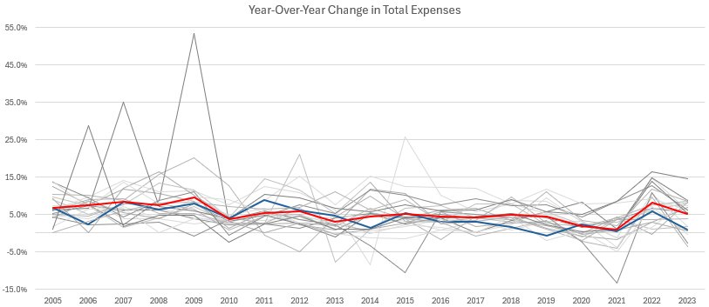
Total Expenses YoY Change

Slide 15
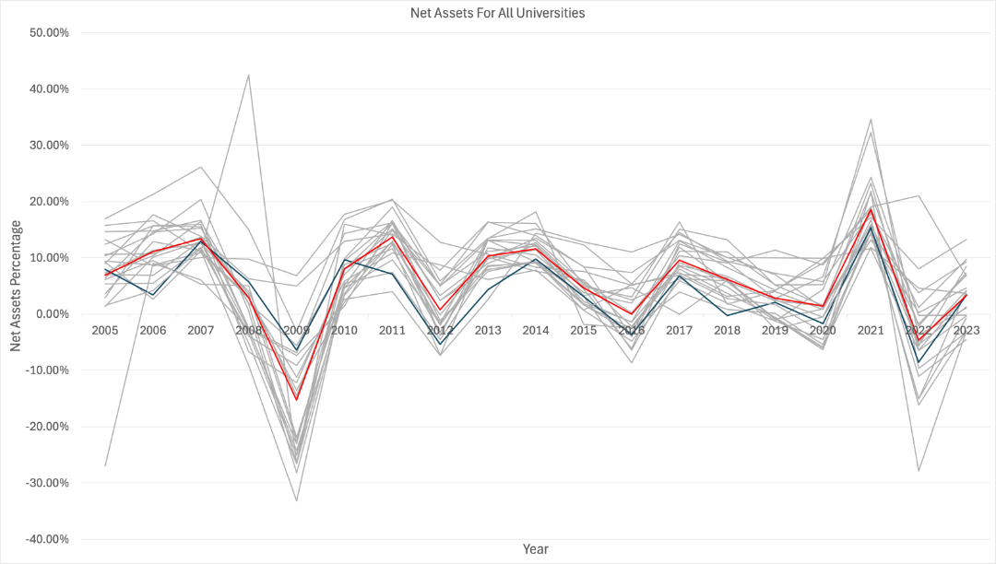
Net Assets
Lesley University displayed an unusual 42.5% net asset value

Slide 16
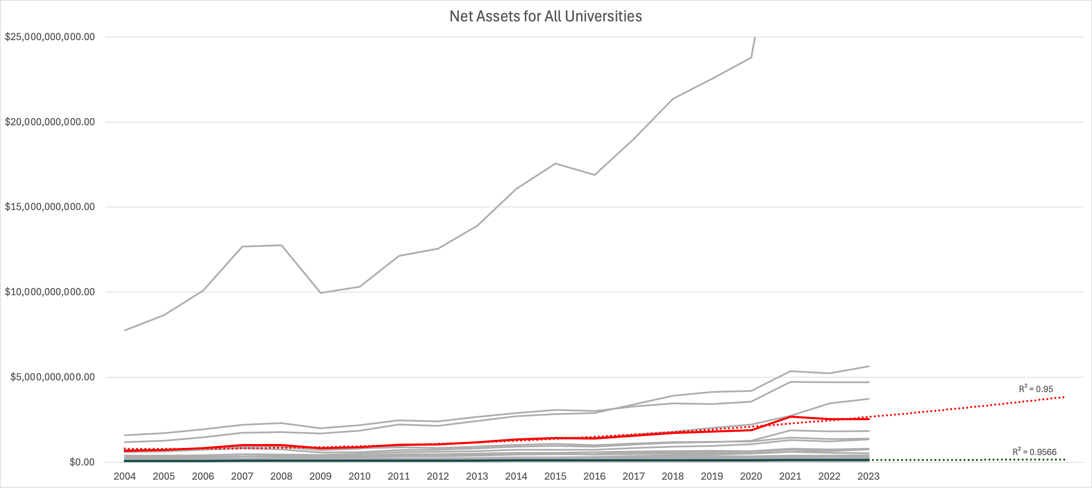
Net Assets
MIT Outlier

Slide 17
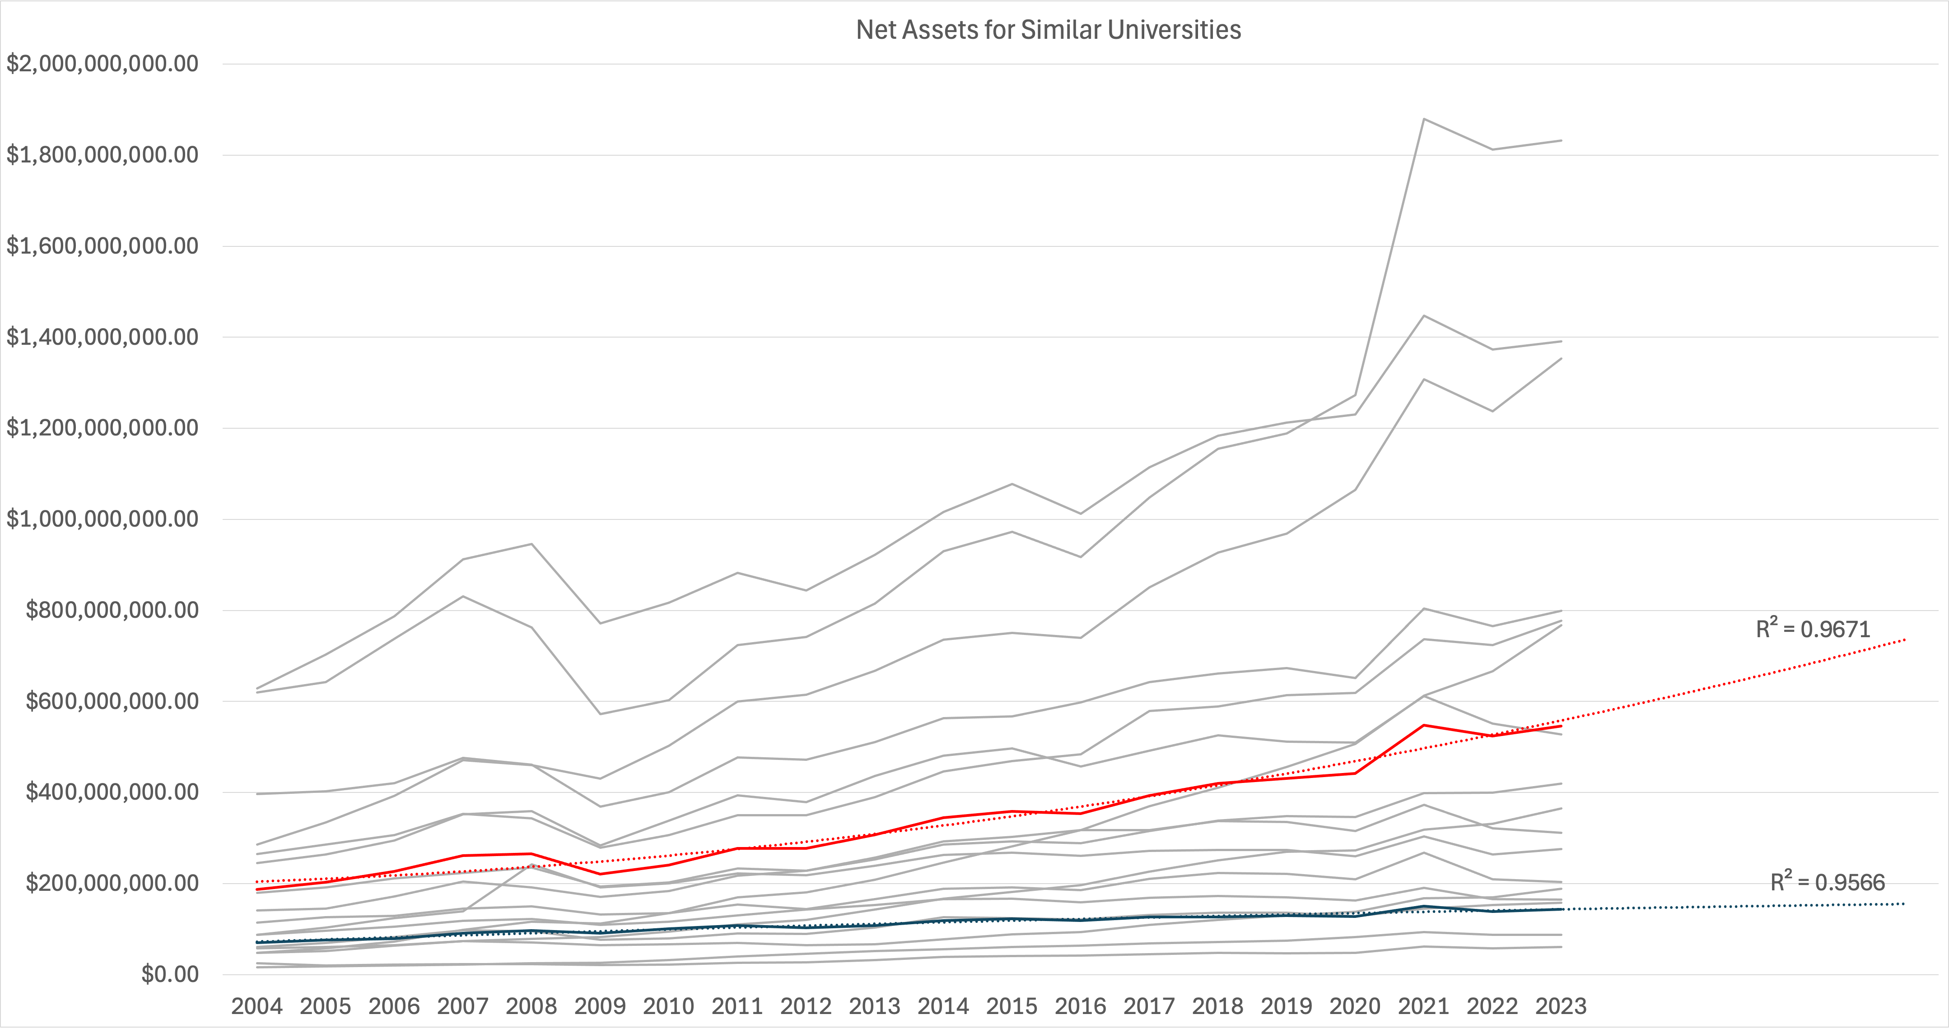
Net Assets
Wesleyan, Brandeis, Quinnipiac University
above average

Slide 18
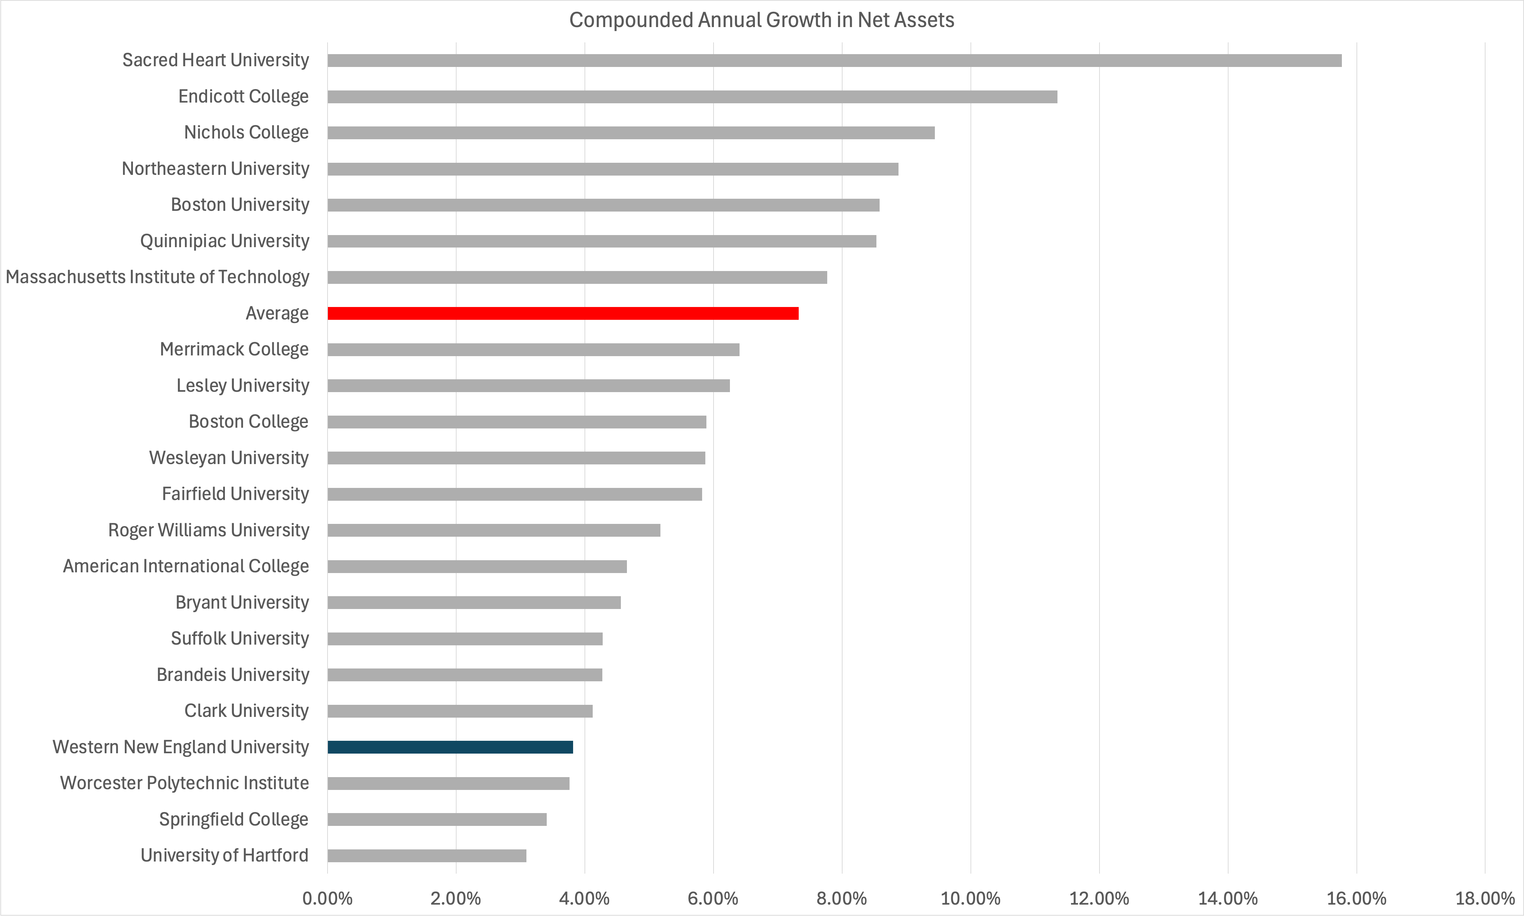
Net Assets

Slide 19
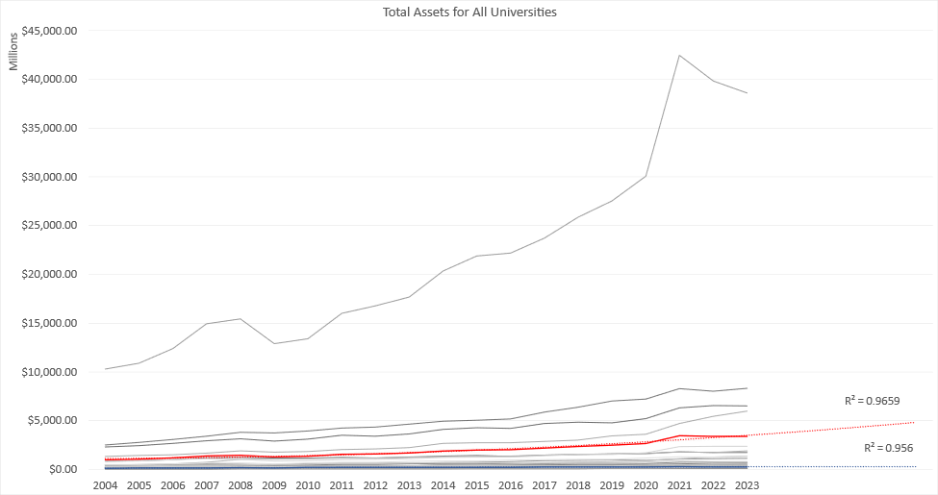
Total Assets

Slide 20
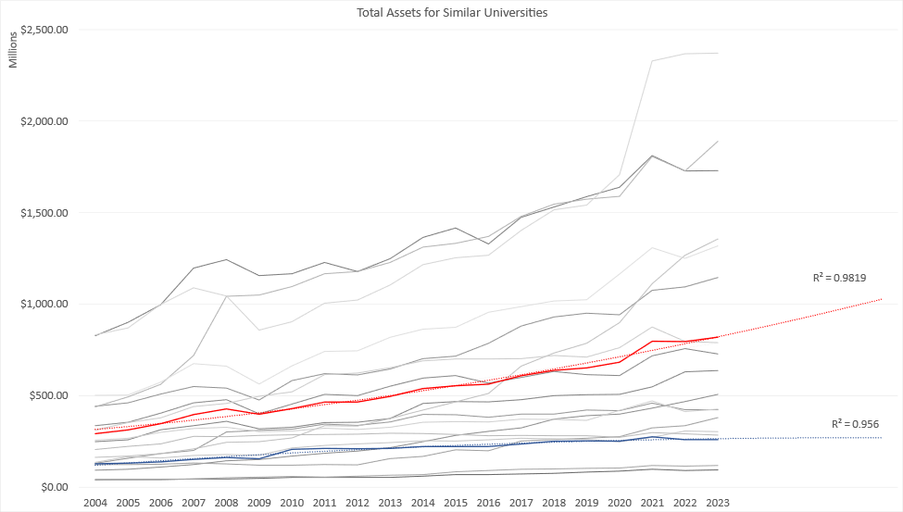
Total Assets

Slide 21
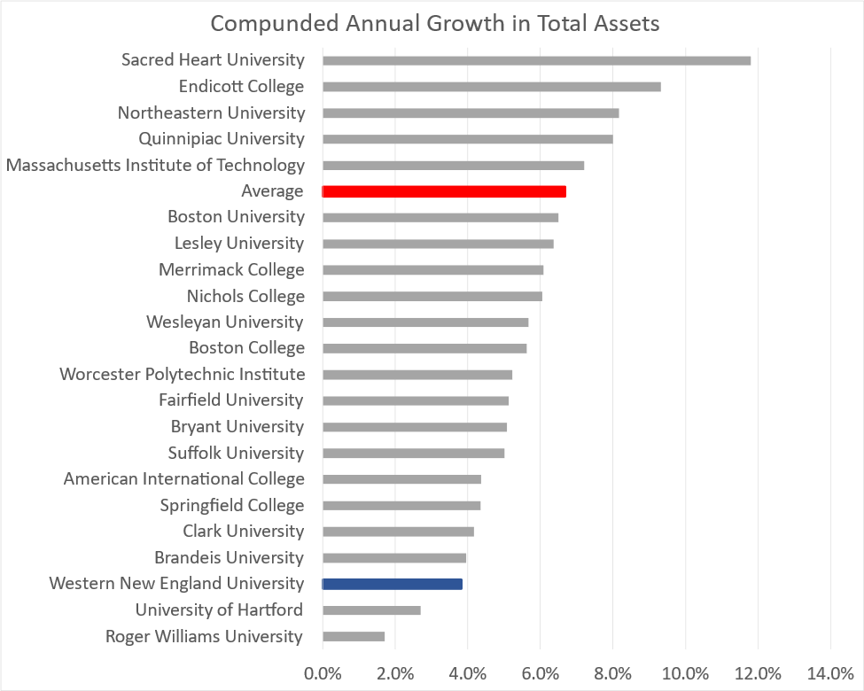
Total Assets (CAGR)

Slide 22
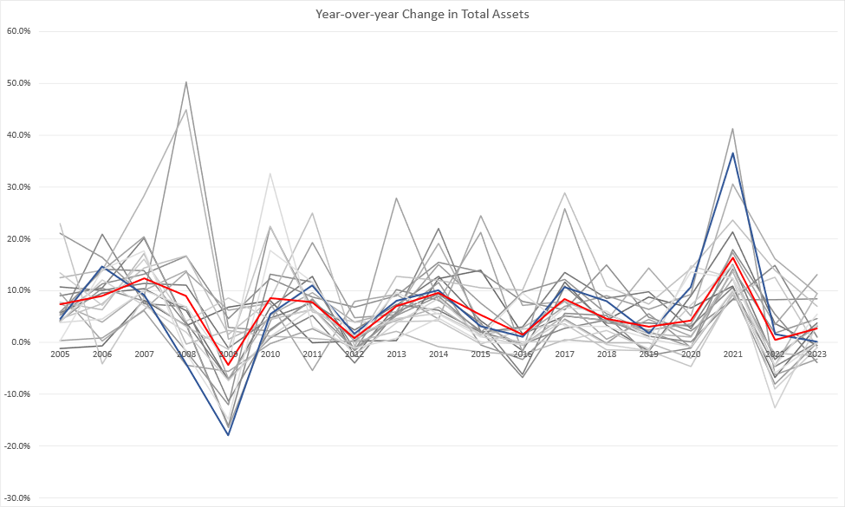
Total Assets (YoY Change)

Slide 23
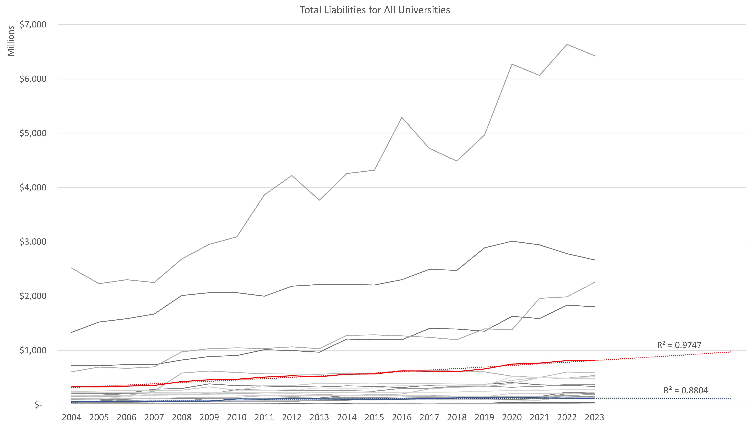
Total Liabilities
MIT

Slide 24
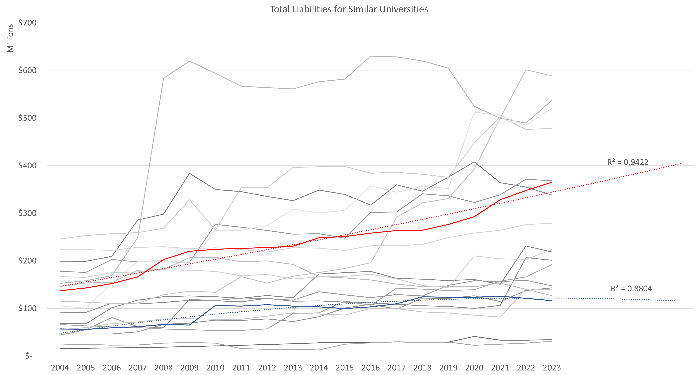
Total Liabilities
Quinnipiac & Sacred Heart

Slide 25
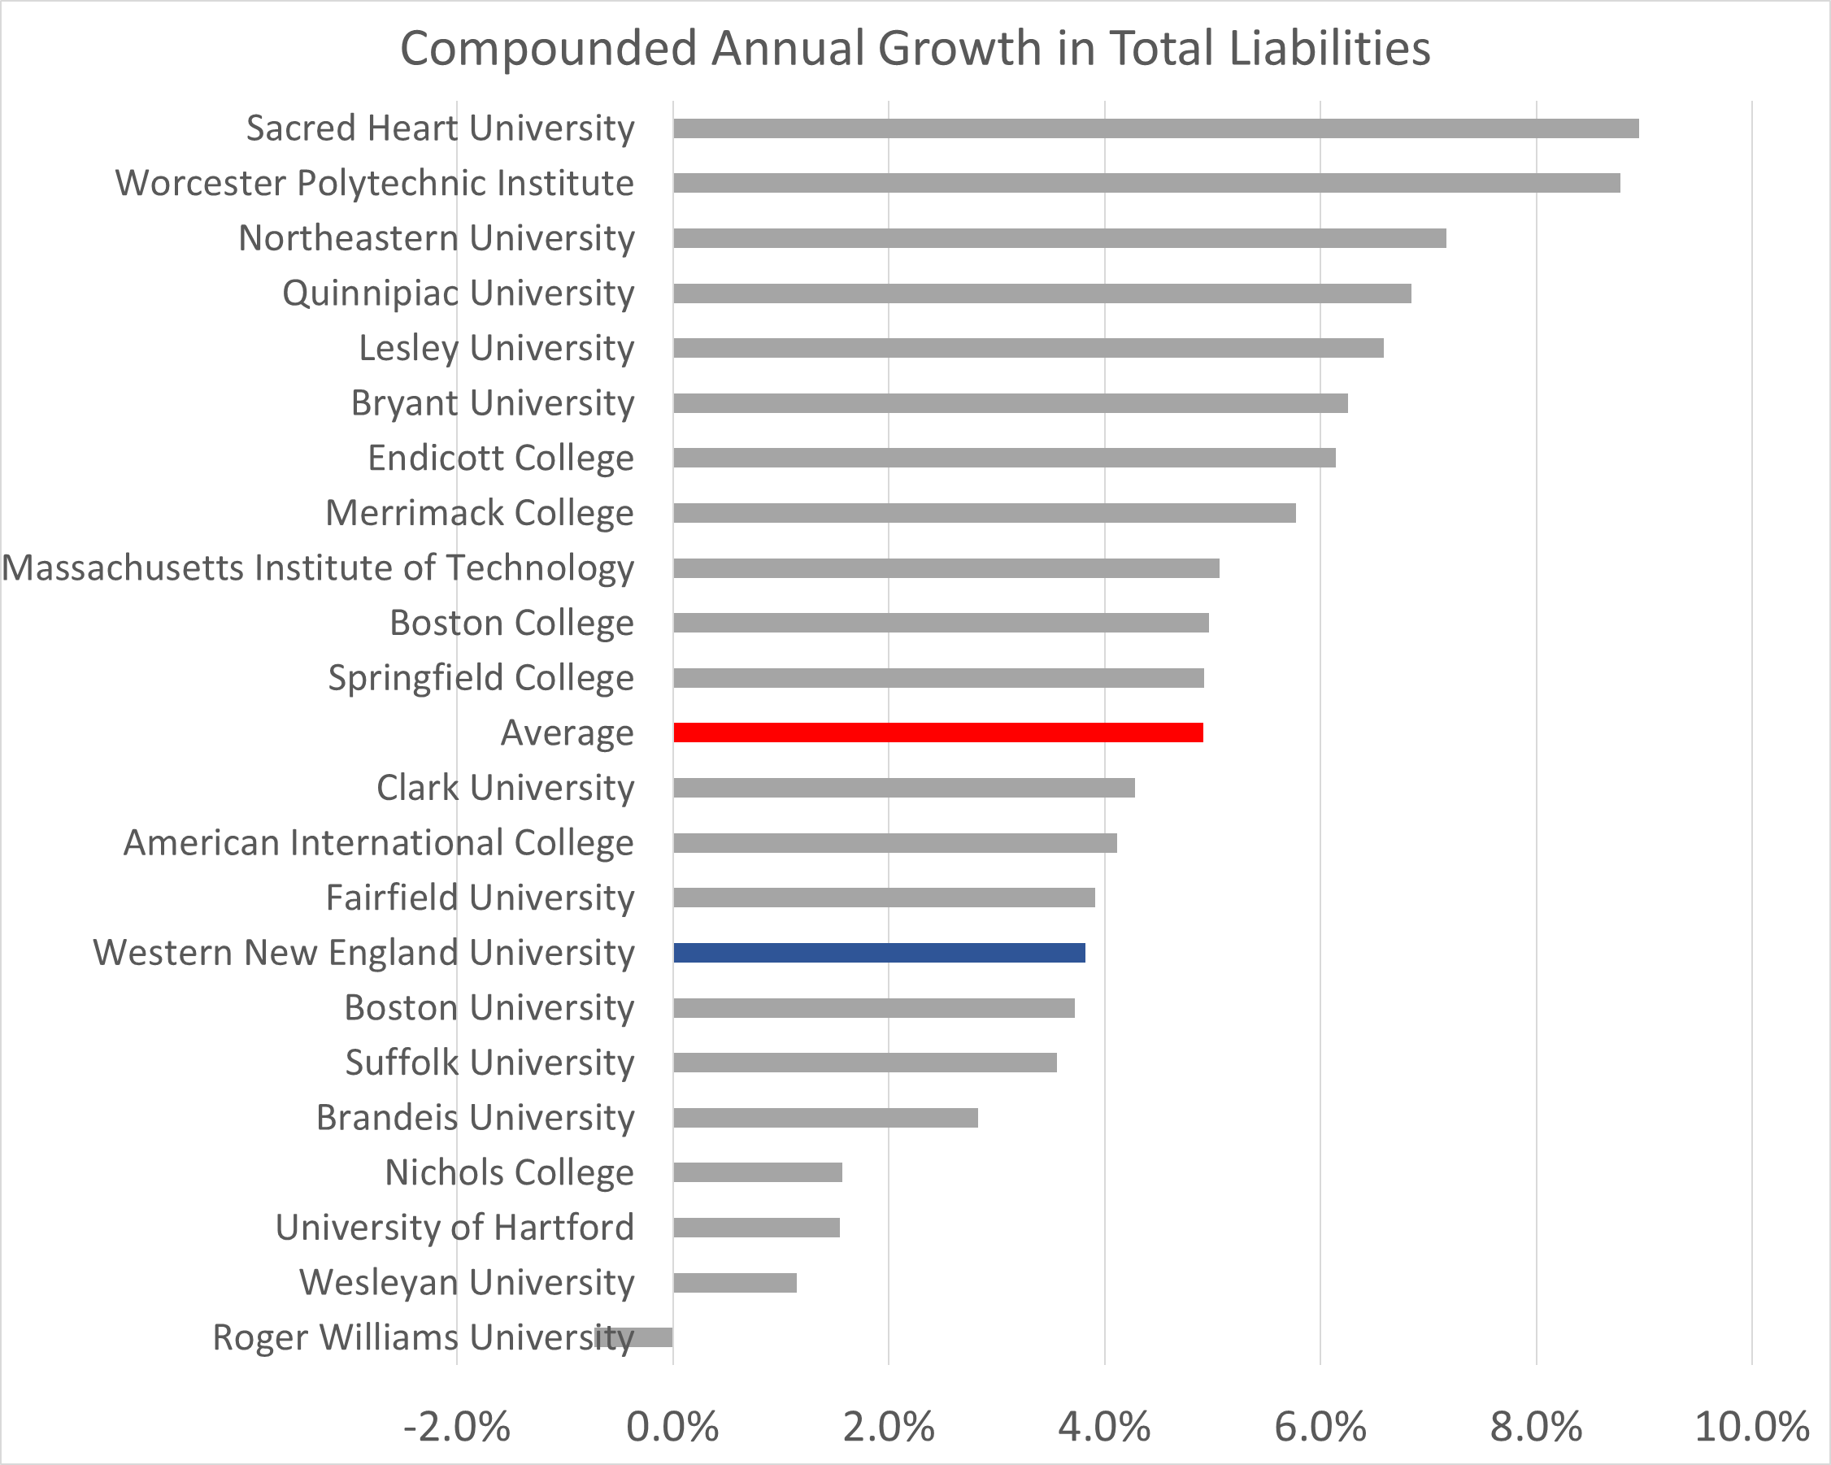
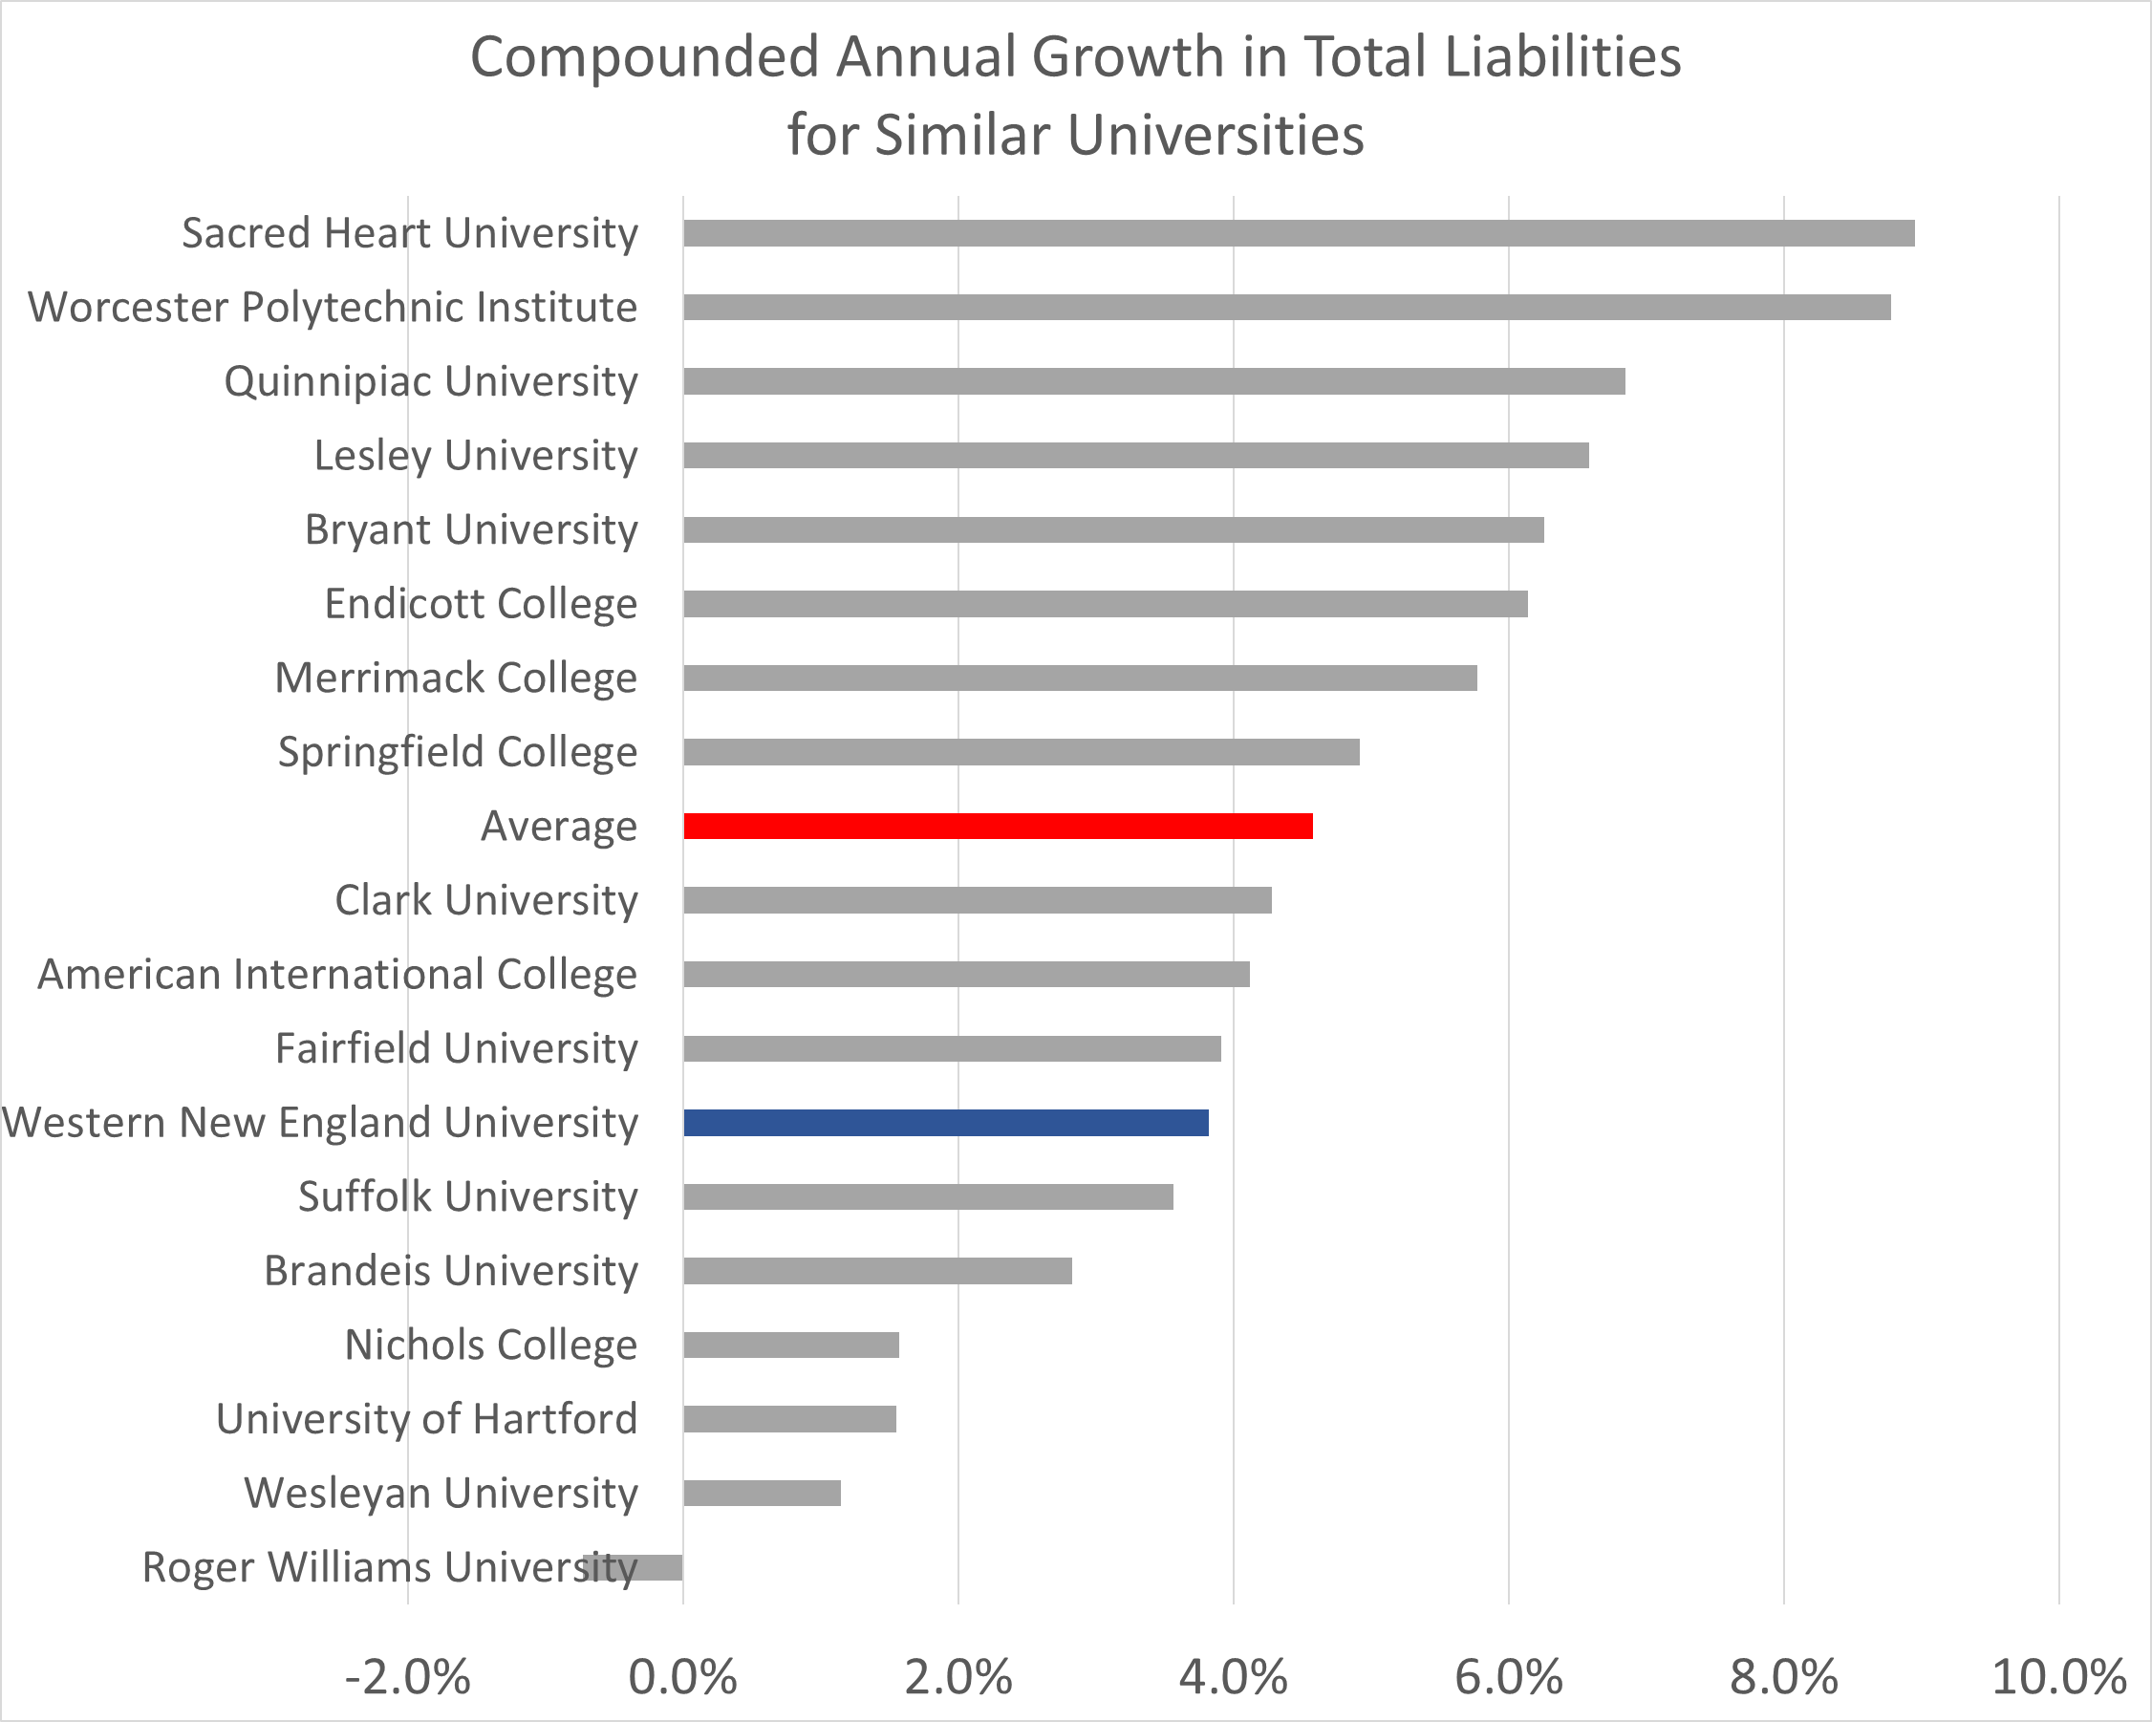
Total Liabilities (CAGR)

Slide 26
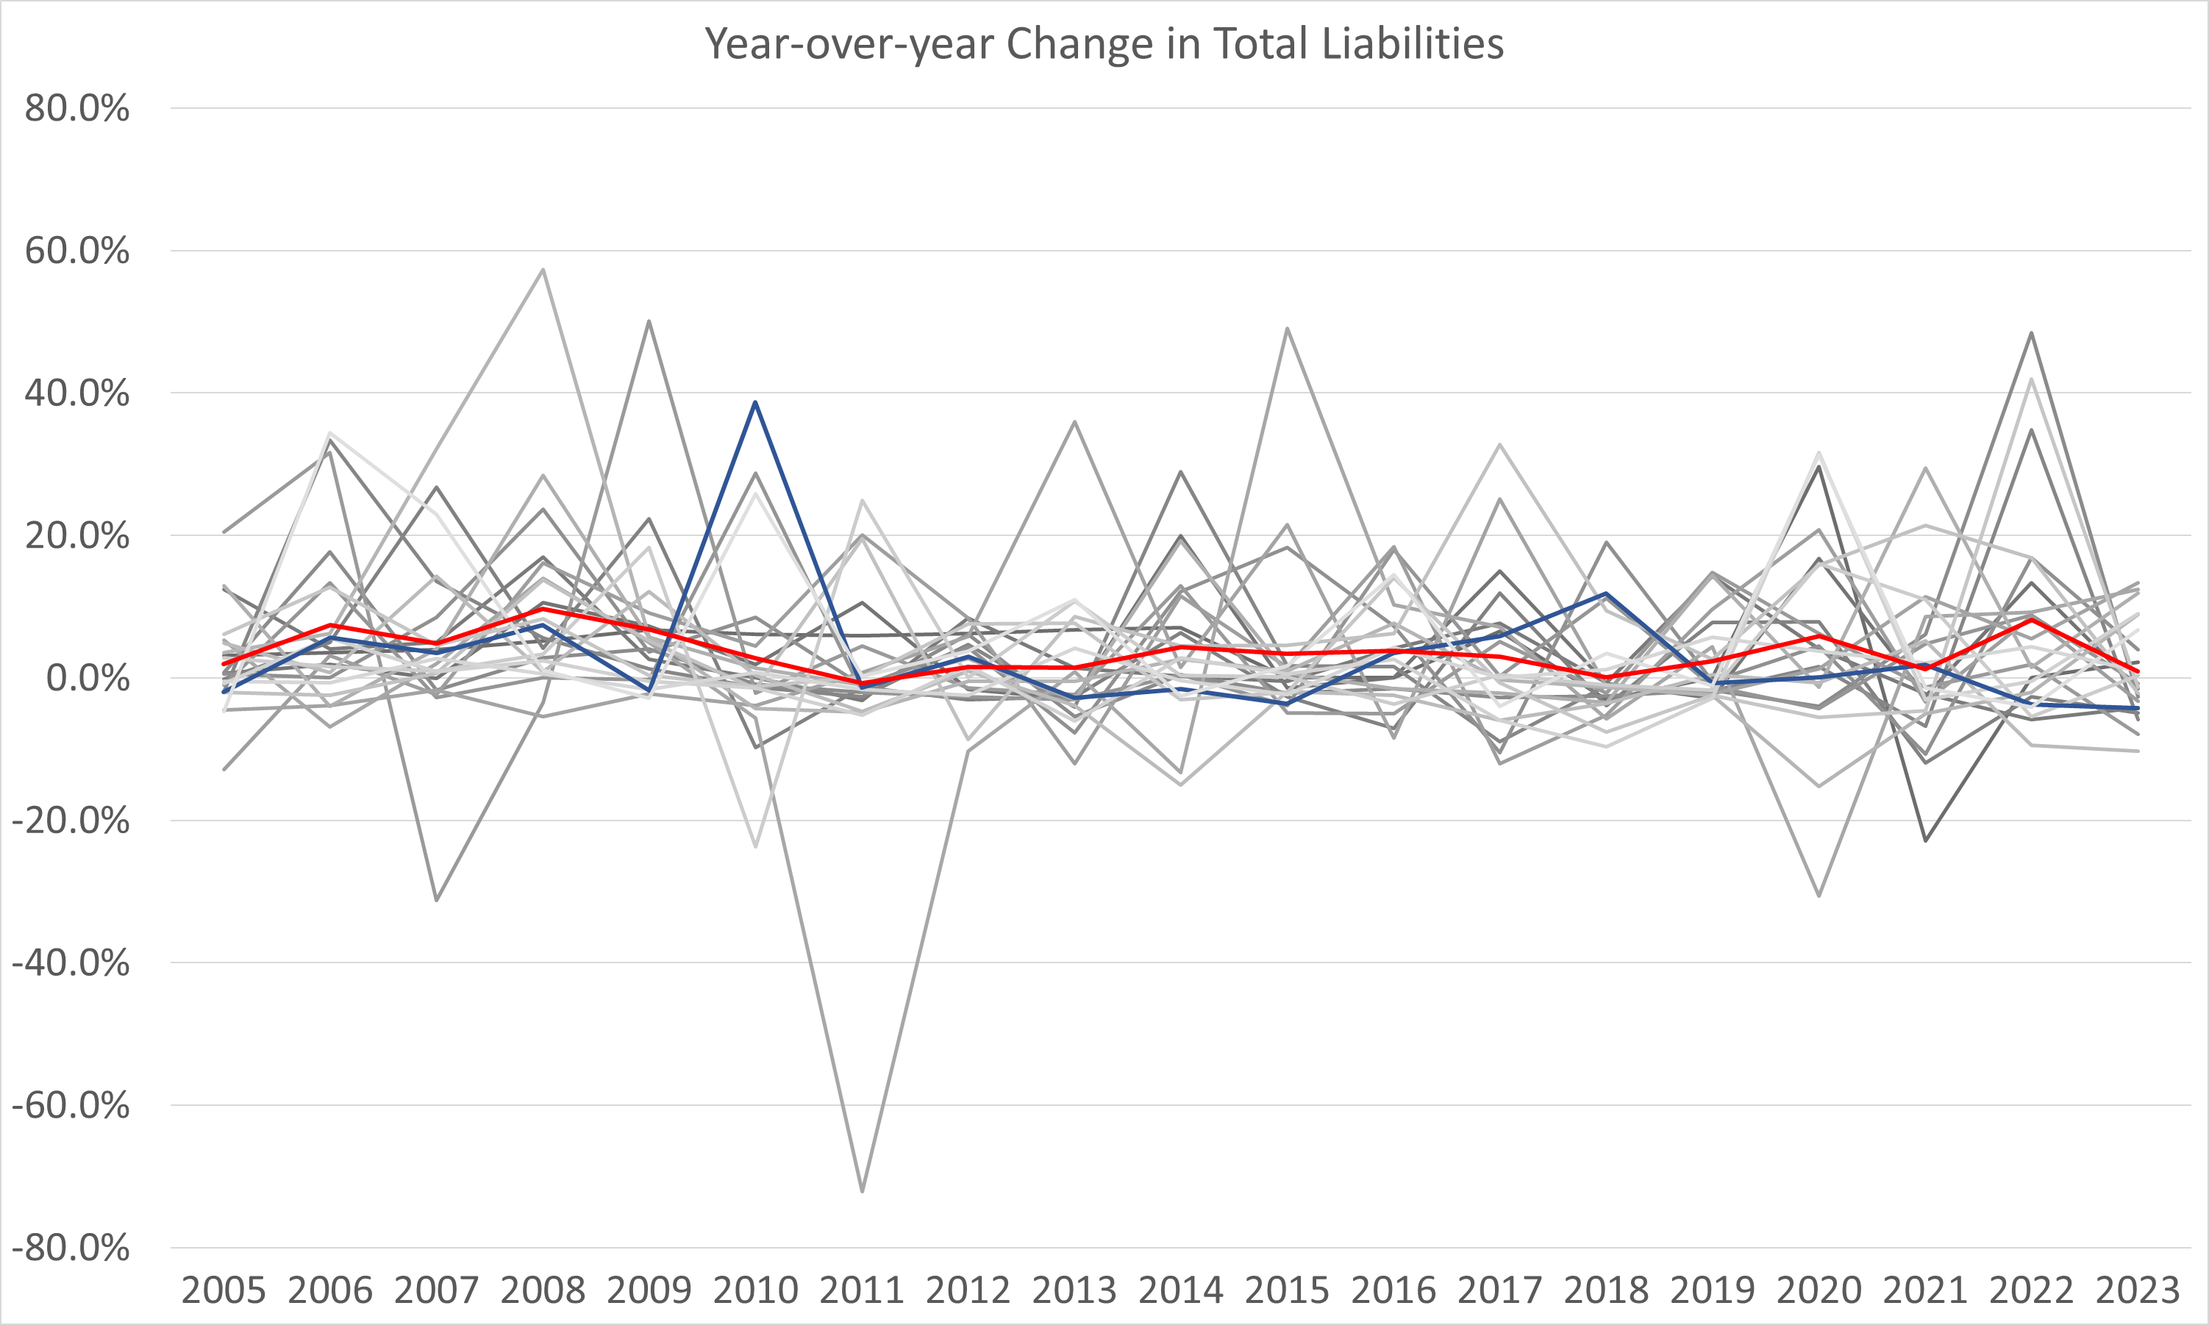
Total Liabilities (YoY Change)

Slide 27
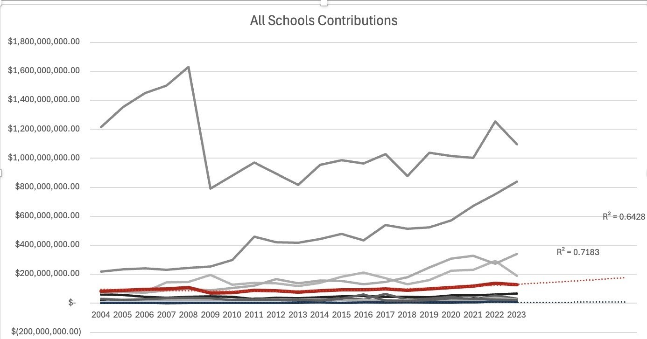
Contributions

Slide 28
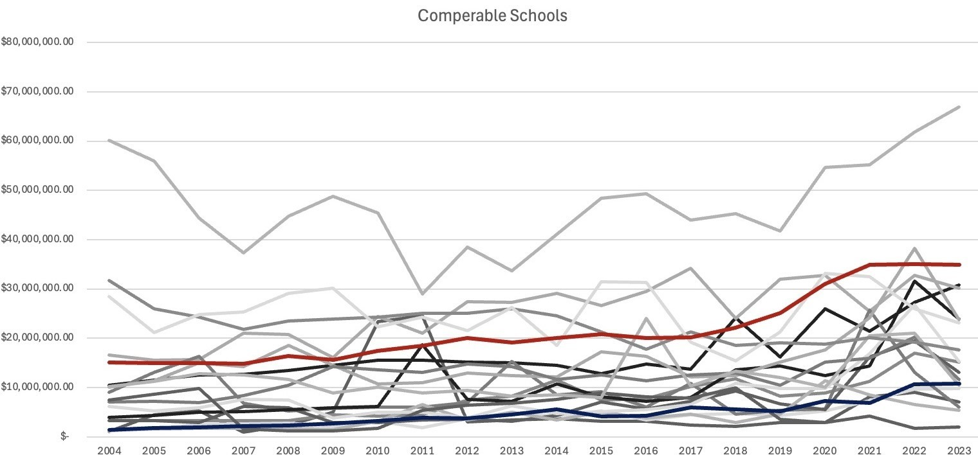
Contributions

Slide 29
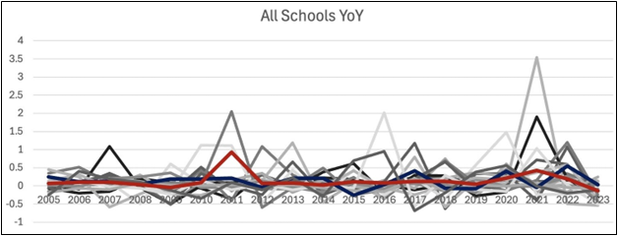
Contributions

Slide 30
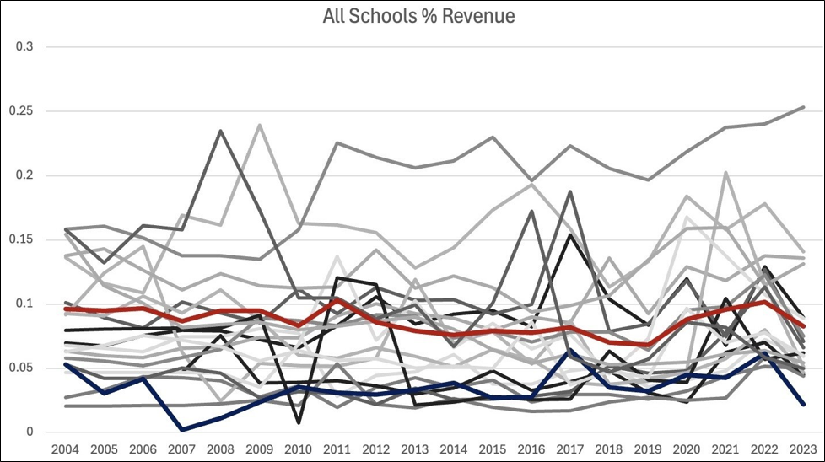
Contributions

Slide 31
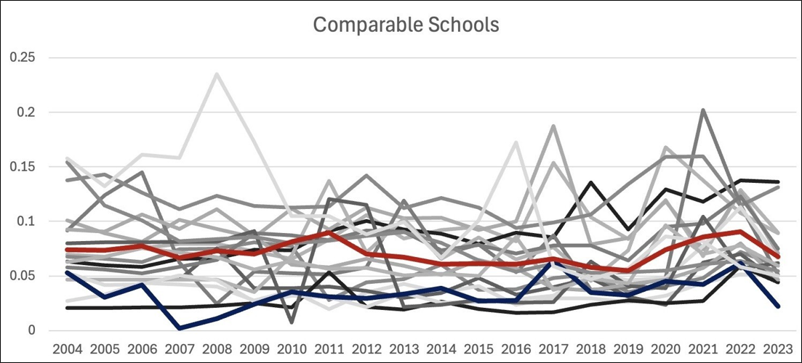
Contributions

Slide 32
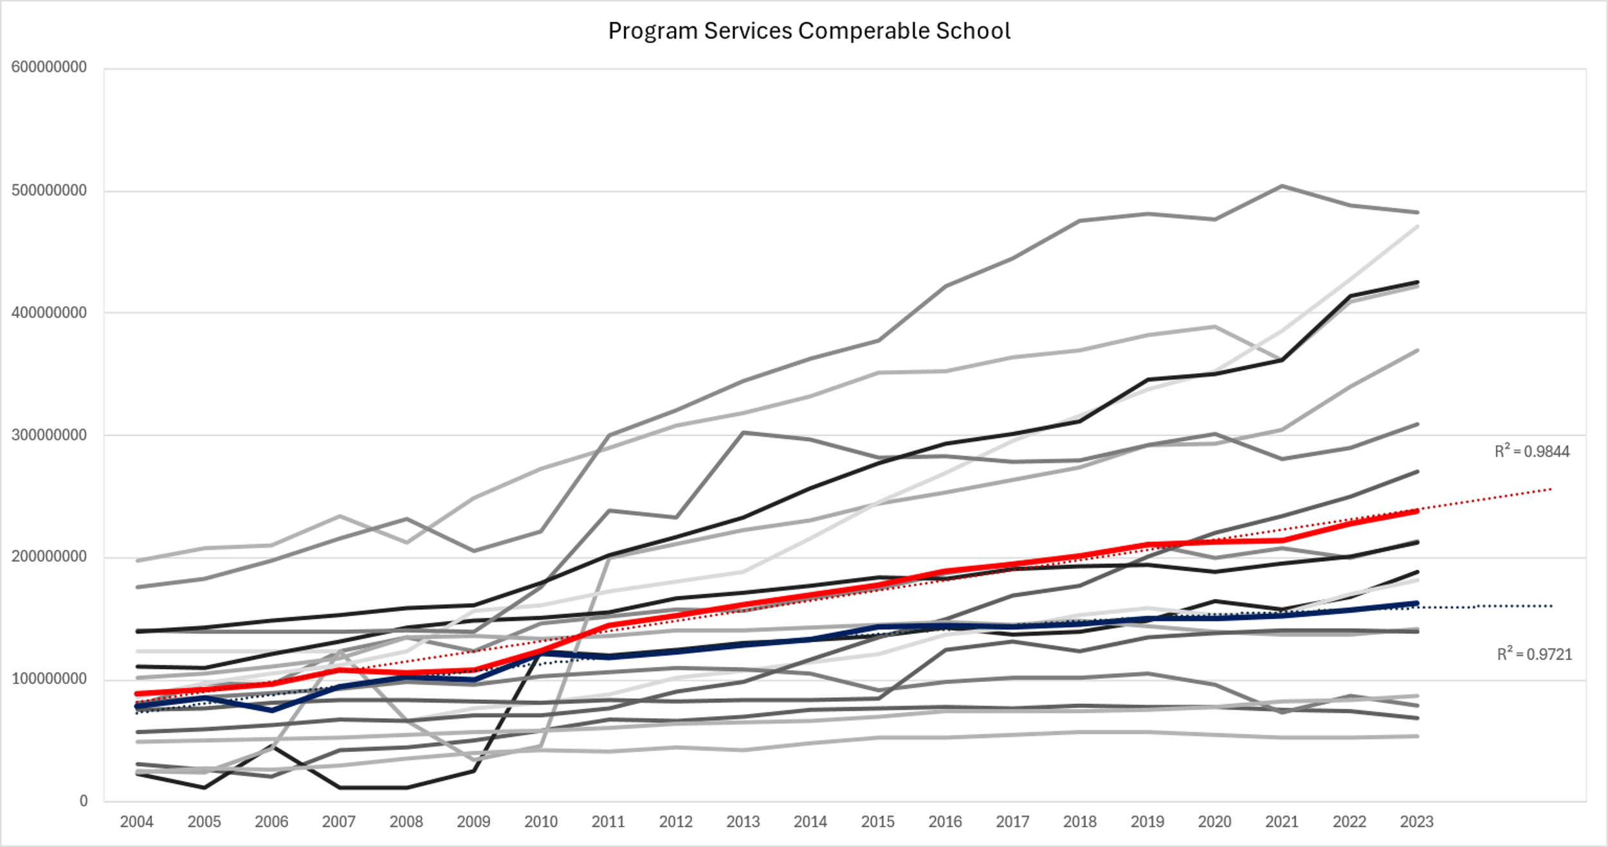
Program Service Revenue
WNE Performs Slightly Below Average

Slide 33
Program Service Revenue
Impressive Growth from WNE

Slide 34
Program Service Revenue
Industry Standard 80-90%

Slide 35
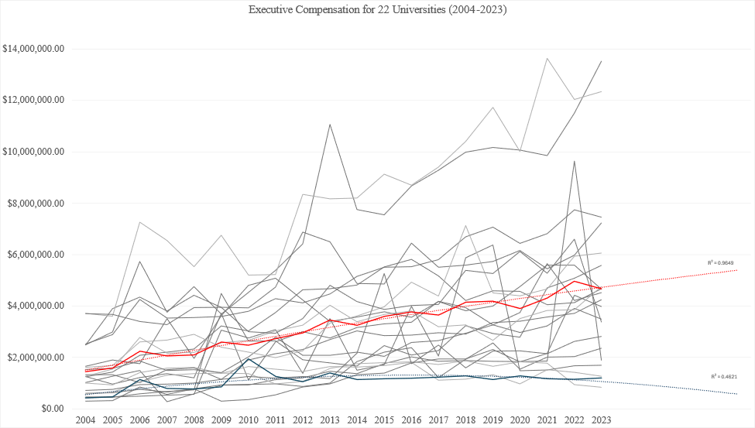
Executive Compensation
MIT & Northeastern
R^2= 0.9648
R^2= 0.4821

Slide 36
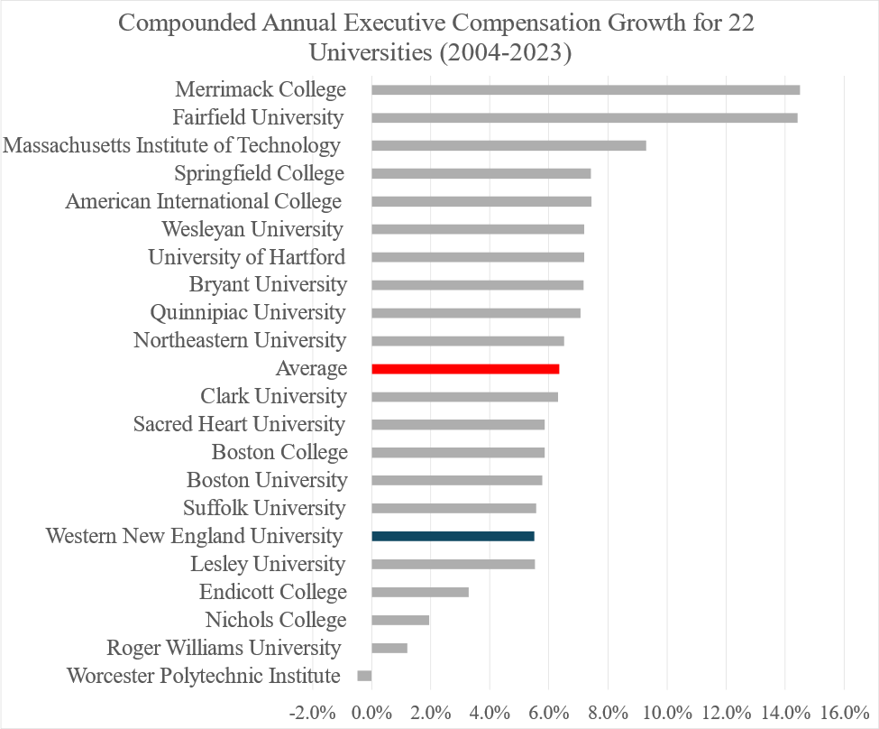
Executive Compensation
Excluding Brandies
Average: 6.3%
WNEU: 5.5%

Slide 37
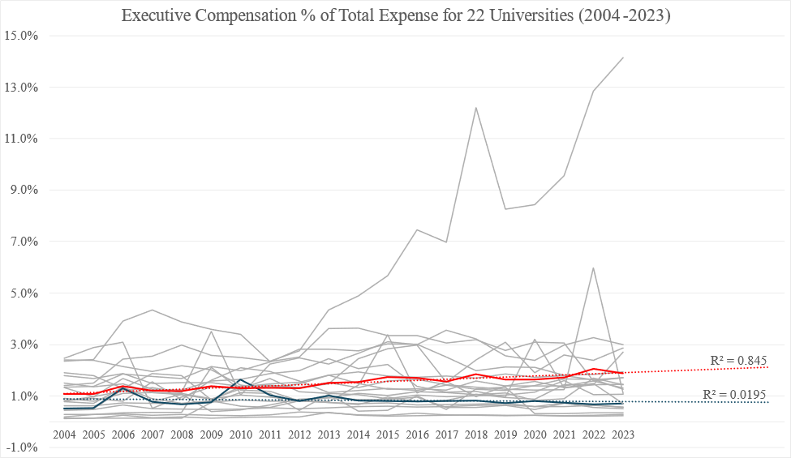
Executive Compensation
Wesleyan
Excluding Brandies University
MIT, Boston College, and Northeastern are below WNEU
Endicott

Slide 38
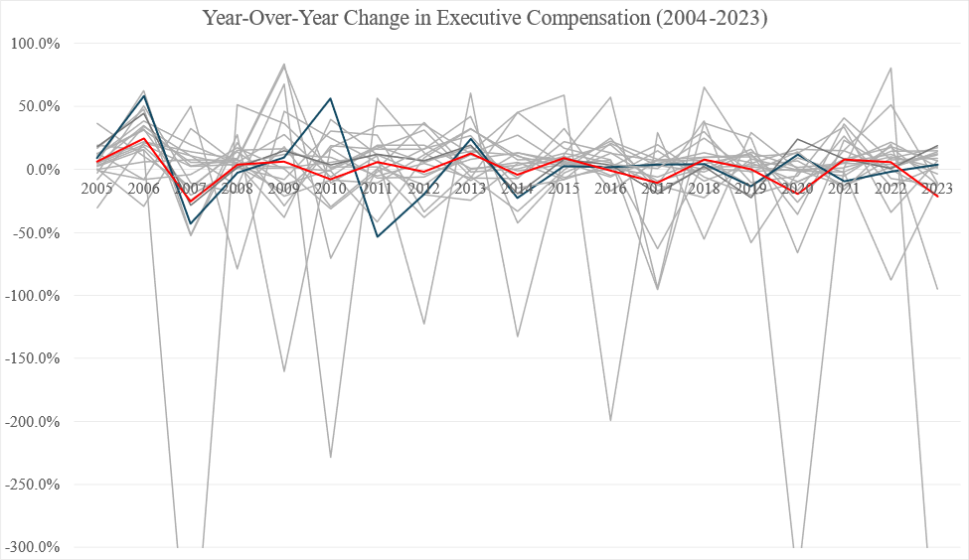
Executive Compensation
Lesley
Quinnipiac
Endicott

Slide 39
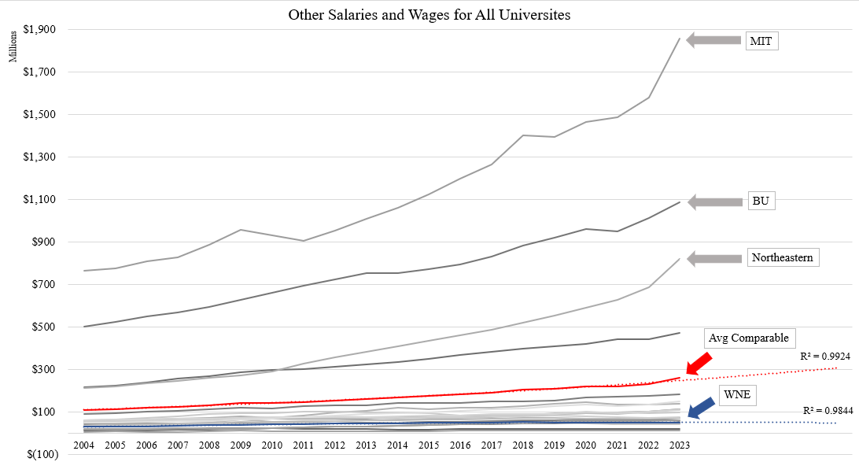
Other Salaries & Wages for All Universities
Aliyah Jackson

Slide 40
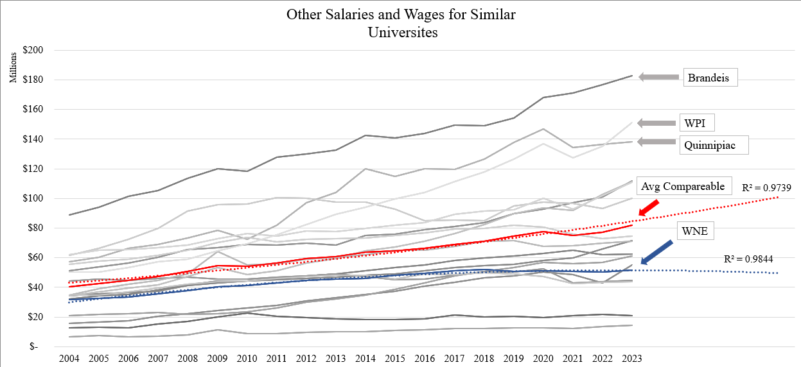
Other Salaries & Wages for Similar Universities
Aliyah Jackson

Slide 41
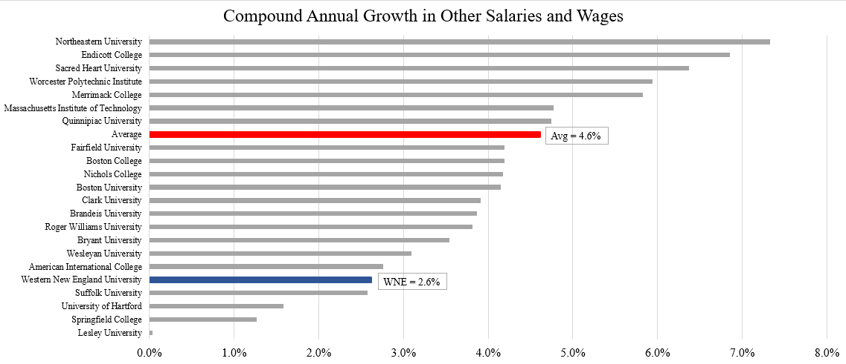
Other Salaries & Wages CAGR All Universities
Aliyah Jackson

Slide 42
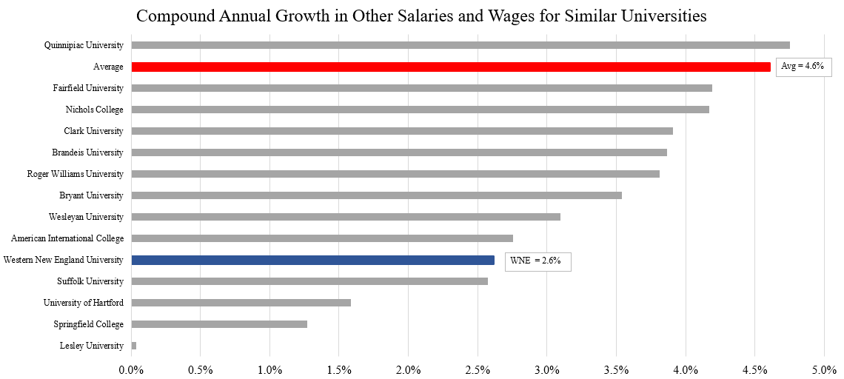
Other Salaries & Wages CAGR Similar Universities
Aliyah Jackson

Slide 43
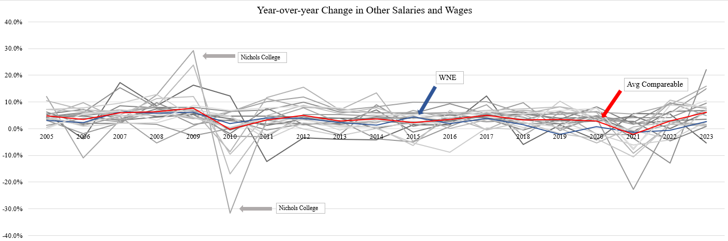
Other Salaries & Wages YoY Growth
Aliyah Jackson

Slide 44
Conclusion
Revenue: WNE showed moderate revenue growth but lagged behind larger universities. Removing top-performing outliers highlighted WNE's stability among peers, though it still fell slightly below the average CAGR.
Expenses: WNE managed steady expense growth with a lower CAGR than peers, reflecting controlled spending. Expense trends indicate prudent financial management.
Net Income: Net income trends reflect challenges due to external economic factors, with WNE experiencing consistent but limited positive performance compared to peers.
Net Assets: WNE demonstrated flat growth in net assets, emphasizing the need for better financial planning and investment strategies to remain competitive.
Total Assets: WNE showed slow growth in total assets, falling behind peer averages. Significant macroeconomic events, such as the 2008 recession and post-COVID-19 recovery, impacted asset totals.
Total Liabilities: WNE maintained a favorable position with low liability growth (CAGR of 3.8%), indicating effective debt management compared to peers.
Contributions: WNE underperformed in fundraising with a negative CAGR, showing a decline in contributions as a percentage of revenue. This highlights missed opportunities for growth.
Program Services Revenue: WNE demonstrated consistent growth in program services revenue, aligned with its peer institutions, with a stable percentage contribution to total revenue.
Executive Compensation: WNE showed balanced growth in executive compensation, aligning with financial health. Variability in other institutions underscored different strategic priorities.
Other Salaries and Wages: WNE lagged behind peers in salary growth, with a CAGR of 2.6%, indicating limited financial flexibility for workforce investments.
These findings underscore WNE’s relative stability but highlight areas for strategic improvement, particularly in revenue diversification, fundraising, and workforce investments.

Slide 45

Questions?

